Slide 1
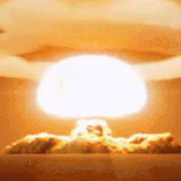

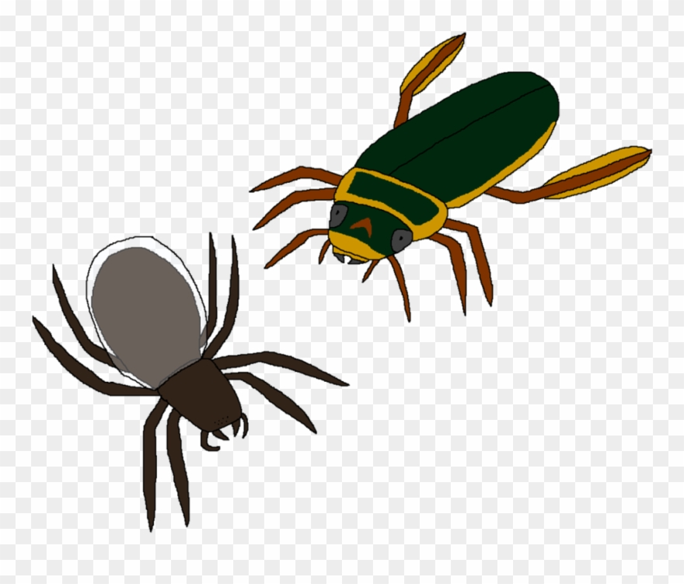




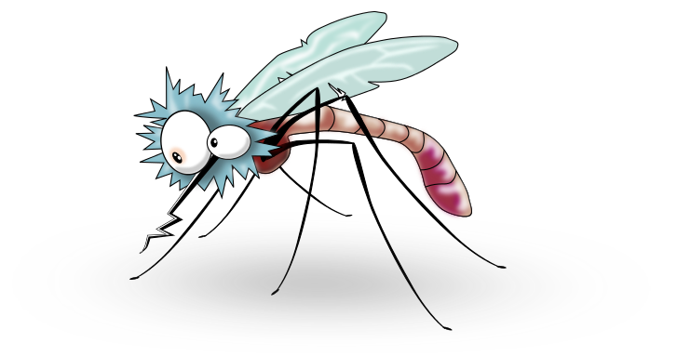


Notes:
Thanks for the introduction. You probably all know that concurrency bugs are hard to tackle.
We will give you a button. Once you click, you will explode thousands of concurrency bugs.

Slide 2

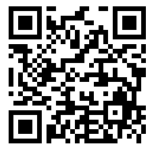



Efficient and Scalable Thread-Safety-Violation Detection
Finding thousands of concurrency bugs during testing
Guangpu Li, Shan Lu, Madanlal Musuvathi, Suman Nath, Rohan Padhye
Notes:
Hello everyone, I am Guangpu from university of Chicago. Our paper “Efficient and scalable thread-safety-violation detection” is a joint work with my advisor Shan, my mentors Madan, Suman and my collaborator Rohan.

Slide 3



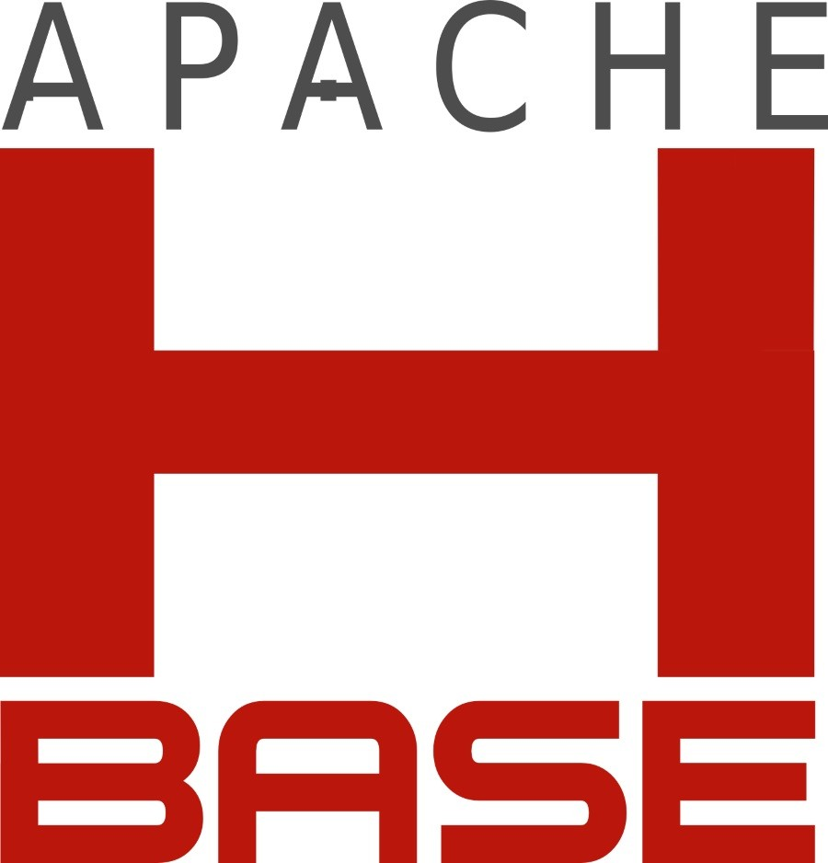






Concurrent programs are everywhere
Notes:
Nowadays, concurrent programs are everywhere in desktops, in mobile phones and in the cloud.

Slide 4
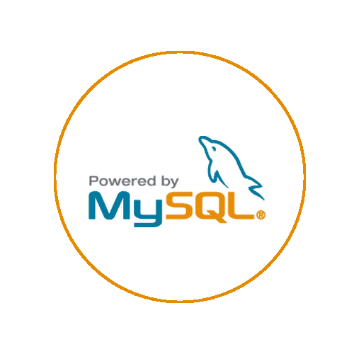

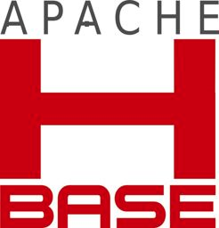
Concurrency bugs are everywhere
MySQL / MYSQL-791
“I think it is too complicated and too risky!”
Hadoop Map/Reduce / MAPREDUCE-4819
“This has become quite messy, sigh.”
Hadoop Map/Reduce / MAPREDUCE-3274
“That is one monster of a race!”
HBase / HBASE-4397
“Do we have to rethink this entire [HBase] …There isn’t a week going by without some new bugs about races?.”
Notes:
concurrency bugs are also everywhere. It is very common to see developers complain about concurrency bugs,
Like "this is one monster of a race", "there isn't a week going by without some new bugs about races".

Slide 5
Concurrency bugs are everywhere
MySQL / MYSQL-791
“I think it is too complicated and too risky!”
Hadoop Map/Reduce / MAPREDUCE-3634
HBase / HBASE-6417
“we [prefer] debugging crashes instead of hard-to-track hanging jobs.”
Hadoop Map/Reduce / MAPREDUCE-4819
“We has already found and fix many case,
however it seems exist many other cases all the same.”
“This has become quite messy, sigh.”
Hadoop Map/Reduce / MAPREDUCE-3274
HBase / HBASE-6060
“That is one monster of a race!”
Hadoop Map/Reduce / MAPREDUCE-4099
This issue, and the other related issues ... makes me very nervous about all the state combinations
“Great catch, Sid! Apologies for missing the race condition.”
HBase / HBASE-4397
“Do we have to rethink this entire [HBase] …There isn’t a week going by without some new bugs about races?.”
Notes:
There are many many more complains about concurrency bugs out there.

Slide 6

Thread-safety violation (TSV)
Thread-safety contract
class MyClass{
public: m1();
m2();
...
}
m1 // m1
m1 // m2
Thread-safety violation
myObj.m1()
myObj.m2()
thread 1
thread 2
Notes:
Our work tackles a critical type of concurrency bugs called Thread Safety Violations.
In object-oriented programs, there are thread-safety contracts associated with classes about which methods CANNOT be concurrently invoked.
A thread safety violation or TSV occurs if two threads concurrently invoke two conflicting methods upon the same object.
The outcome of such a method race could be crashes or severe software misbehavior.

Slide 7
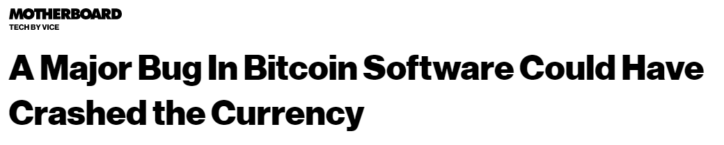
Thread-safety violation example
Class List {
public:
Add(...);
Get(...);
...
}
Thread-safety contract
class MyClass{
public: m1();
m2();
...
}
m1 // m1
m1 // m2
Add // Add
Thread-safety violation
mylist.Add(x)
mylist.Add(y)
myObj.m1()
myObj.m2()
thread 1
thread 2
thread 1
thread 2
Notes:
Let’s take an example. In C#, there is a widely used class called List in system.collections namespace. The C# document explicitly says that two add methods of the same List cannot be invoked at the same time.
Otherwise thread-safety violation will happen and one element will be lost.
Unfortunately, such a thread-safety violation widely exist in practice and is very difficult to find during in-house testing.
In 999 testing runs, two concurrent calls to Add may execute one after the other, but in 1 production run, they may execute at the same time, causing huge problems like bitcoin losses.

Slide 8

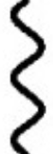
Reasoning about TSVs is difficult (I)
too many possibilities of concurrency
Multithreading
Event-driven
Message passing
Notes:
In fact, it is very difficult to reason about whether there is a thread-safety violation or not, particularly in cloud service code that we target.
There are all types of concurrency going on, such as multi-threading, asynchronous event processing in each node, and message passing across nodes.

Slide 9
Reasoning about TSVs is difficult (II)
too many forms of synchronizations
lock.Lock()
Obj.notify()
RPC_wait()
semaphore.Require()
pthread_mutex_lock()
While(flag != 1){}
Obj.wait()
Obj.signal()
Event.WaitOne()
Thead.join()
synchronized{…}
monitor.tryenter()
monitor.exit()
RPC_wait()
Notes:
And there are all kinds of standard and custom synchronization primitives out there, very difficult to comprehensively reason about.
You may notice that TSV is very similar to data race.

Slide 10





In small scale, it is fine.
Program source code
Integration
Static data-race analysis
Pruning
~1 out of 5
Test Inputs
Program
binary
Integration
Dynamic data-race analysis
Pruning
~10x[1]
~1 out of 2
[1]"FastTrack: efficient and precise dynamic race detection." PLDI 2009.
Notes:
With existing data-race detection tool, detecting thread-safety violations in small scale is doable.
You can take a static analysis tool, tweak it so that it integrates with whatever concurrency and synchronization primitives used by the target program. and then manually analyzing the bug reports to identify typically 1 true bug out of 5 to 10 false reports.
Alternatively, to lower the manual effort, you can apply dynamic analysis while running the program under test inputs, for example happens before analysis detection. It still requires integration like annotating synchronization primitives. It also needs false-positive pruning because in practice the annotation is not perfect. Moreover, it will slow down the testing run by about 10 times or more.

Slide 11


In large scale, it is NOT fine.
CloudBuild: 100M tests from 4K teams, up to 10K machines /day
Tests inputs
Program
binary
Integration
Dynamic data-race analysis
Pruning
10x
x10
Notes:
Clearly, existing techniques do not work in large scale.
For example, In Microsoft, the testing framework cloud build processes millions of unit tests from 4000 teams per day and use up to 10 thousands machines to finish the testing on time .
Existing static tools cannot scale for the large code base.
Existing dynamic tools will require huge effort
to integrate with the thousands of teams that use different ways of synchronization and concurrency;
Manually analyzing the huge number of bug reports also costs a lot.
Particularly, to meet the testing deadline, tens of thousands of extra machines will be needed to run the test cases, which is unacceptable.

Slide 12
Three challenges
Integration
Overhead
False positives
Notes:
To address all these three challenges --- integration, overhead, and false positives

Slide 13

TSVD
A scalable dynamic analysis tool for TSVs:
Test inputs
Dynamic analysis
Program
binary
Integration
Testing run
Pruning
TSVD
*1134 >> others
Thread-safety
contracts
Push-button
30% overhead
0 false positive
Notes:
We design TSVD , a scalable dynamic TSV detection tool.
Using TSVD is very easy.
It does not need to know what type of concurrency exists in the program;
It also does not require the knowledge of what type of synchronization is used.
You only need to provide it with thread-safety contracts; then push button, run the program under any test inputs.
When the test run finishes with only about 30% run-time overhead, and thread-safety violations will be reported, with 0 false positives.
We have deployed TSVD in Azure. So far, it has found more than 1000 thread-safety violations, more than what alternative techniques can find even if we give them much longer time to run.
%%%%%%(6.5Min)

Slide 14
TSVD
Motivation
TSVD design
Evaluation
Conclusion
Notes:
Next, let me tell you what is the secret sauce behind TSVD.

Slide 15

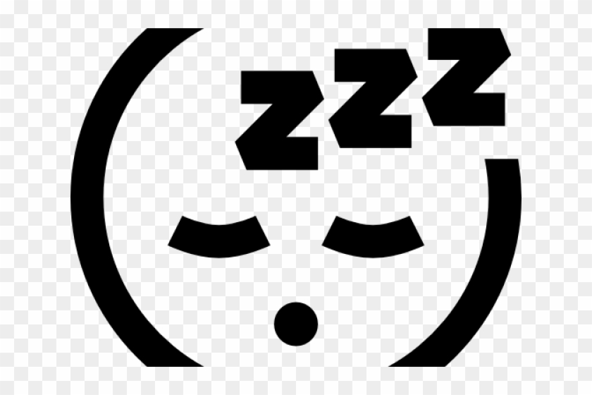
How to achieve zero false positive?
Report after violation
+ inject delays to trigger violations
mylist.Add(x)
mylist.Add(x)
mylist.Add(x)
mylist.Add(y)
thread 1
thread 2
Notes:
First how to achieve zero false positive?
It’s simple, we can only report a TSV AFTER the violation occurs.
But this doesn't solve the problem, because thread-safety violations rarely occur.
So, the real solution is, after we identify a call site that can potentially violate the thread safety contract. Next time when this call site is executed in the same run, we insert delay to slow it down.
If a conflicting call executes during this delay, a true bug is found.
Now the question is how to identify these potentially unsafe calls to insert delays.

Slide 16
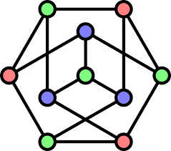
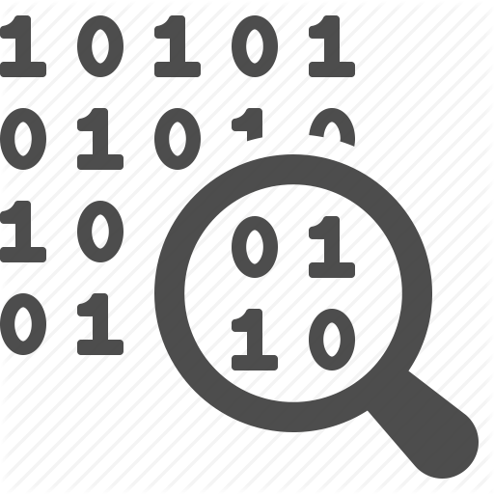
What are potential unsafe calls?
Happen-Before analysis
lock.Lock()
Obj.wait()
Obj.signal()
Cost of delay
monitor.exit()
Every call
Every racing call
[DataCollider, …]
[RaceFuzzer, …]
0
Cost of identification
Notes:
There are different options if we follow previous approaches on data-race detection.
We could do happens-before analysis, analyzing all the synchronization in the program, and carefully identify every call that can potentially execute in parallel with conflicting calls. And only inject delays there.
This analysis will be very expensive and require much integration effort to annotate all synchronization primitives.
We could scan the binary file and treat every call site of every method that is part of a thread-safety contract as a potentially unsafe call.
This identification has almost no cost.
But it will lead to many delay injections and huge run-time overhead.

Slide 17
What are potential unsafe calls?
Every call
[DataCollider, …]
Every likely racing call
Cost of delay
TSVD
Every racing call
[RaceFuzzer, …]
0
Cost of identification
Notes:
What can we do?
TSVD takes a middle ground in the design space and injects delays at likely racing calls.
It does not introduce tons of delays because it is selective;
It also does not use expensive analysis or complicated integration, because it only aims to identify likely racing calls.
So, HOW exactly do we do that?

Slide 18

Racing Calls
likely
Two conflict methods
Called from different threads
Accessing the same object
having concurrent logical timestamps
mylist.Add(y)
mylist.Add(z)
thread 1
thread 2
lock.Lock()
Obj.wait()
close-by physical
Obj.signal()
monitor.exit()
Notes:
You may already know the definition of racing calls:
Two conflict methods based on thread-safety contracts, like two Add
from different threads
on the same object
At exactly the same time or at logically concurrent time
That is a race.
To figure this out, we need expensive synchronization annotation, happens-before analysis, like 10X slow down.
Instead, TSVD looks for likely racing calls, where two conflicting calls from different threads to the same object occur within a short physical time window.
No synchronization analysis need; no logical time computed.

Slide 19
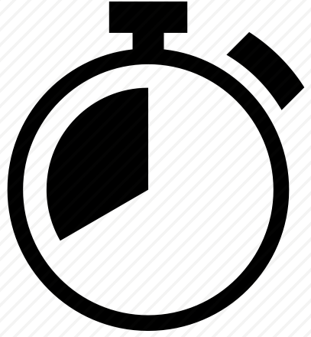
Identify likely race calls
mylist.Add(x)
likely racing list
mylist.Add(y)
Operation1 | Opeartion2
mylist.add(x) | mylist.add(y)
mylist.Add(x)
mylist.Add(y)
thread 1
thread 2
Notes:
For example
At run time (click), TSVD tracks the physical timestamp of every method call.
Whenever two conflict calls have close-by timestamps, (click) they are added to a likely racing list. (click)
When any call-site in this list is executed (click) later in the same run, delays will be injected.(click)
+ And, if another conflicting call (click) executes during the delay, we find a real bug (click).
Very simple.
Of course, we can do even better.

Slide 20
Remove unlikely race calls
Lock()
mylist.Add(x)
Unlock()
Lock()
likely racing list
mylist.Add(y)
Operation1 | Opeartion2
mylist.add(x) | mylist.add(y)
Unlock()
Lock()
mylist.Add(x)
Loop
Unlock()
Lock()
thread 1
mylist.Add(y)
Notes:
You probably already wonder (click) what if there is actual a synchronization between two calls in a small time window?
Then, No matter how we inject delays (click), they will never execute at the same time. (click)
This is particularly bad (click)
If this call is executed for many times. The delays will just introduce a lot of unnecessary slowdowns.
(click) It would be great if we can remove this pair from the likely racing list to avoid these slowdowns.
But how can we do it without expensive happens-before synchronization analysis?

Slide 21


Insights for synchronization analysis inference
Many ways to implement synchronization:
Obj.wait()
While(flag != 1){}
lock.Lock()
RPC_wait()
Thead.join()
One common effect of all synchronizations:
If m1 synchronized before m2 and m1—m2 are nearby
delay to m1 will cause delay to m2
Notes:
TSVD conducts light weight synchronization inference, NO synchronization analysis.
The key insight is that
Although there are many ways to implement synchronizations, which introduces big challenges to accurate synchronization analysis,
All these synchronizations share one common effect
That is, if two calls are synchronized and close by in physical time, a delay to one will cause a transitive delay to the other.

Slide 22
Synchronization inference: transitive delay
mylist.Add(x)
likely racing list
Operation1 | Opeartion2
mylist.add(x) | mylist.add(y)
No-progress
Unlock()
Any synchronizations
Lock()
mylist.Add(y)
thread 1
thread 2
Notes:
Leveraging this insight, When TSVD injects a delay, it also monitor the progress of other threads. If another thread, thread 2, cannot make progress for a long time until the end of the delay, TSVD will infer a synchronization between the delayed call in thread 1 and the next few calls in thread 2, and remove corresponding pairs from the likely racing list.
This inference can work for all types of synchronizations, not just locks.

Slide 23
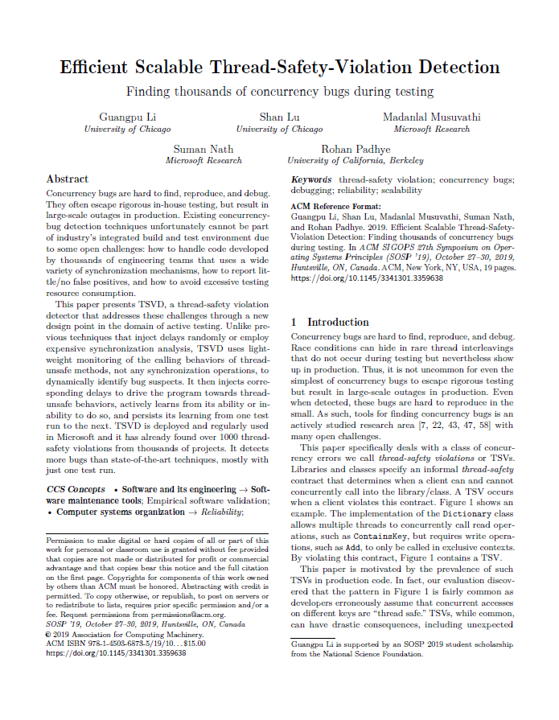
More TSVD details
TSVD likely racing calls
TSVD inference
- Is there exist a synchronization?
Is the program running in a sequential mode?
Is a likely racing call less likely than another?
TSVD multiple runs
Earlier runs’ knowledge will be inherited by later runs
Notes:
So far, we have covered how TSVD identifies likely racing calls and how TSVD infers a synchronization.
TSVD actually infers more properties:
Is the program running in a sequential mode?
Is a likely racing call less likely than another?
If resource allows, TSVD supports running a test multiple times:
Earlier runs’ knowledge will be inherited by later runs.
Due to time limit, please check our paper for details.

Slide 24


TSVD Review
likely racing list
Operation1 | Opeartion2
Next run
Add
Read
Remove
Thread-safety
contracts
30% overhead
Push-button
0 false positive
Notes:
To summarize, this is how TSVD works.
TSVD takes binaries as input and instruments them base on thread safety contracts. The instrumentation is a push-button design because our dynamic analysis mostly relies on the physical timestamp of a call.
During runtime, TSVD maintains a likely racing list.
After starting running, TSVD adds to the list base on physical timestamp, reads list to inject delay, removes form list by delay feedback and reports bugs.
It keeps low overhead and zero false positive.
If the resource allows, TSVD will pass the remaining entries in the list to next run.
%%%%%%%%[12-13min]

Slide 25
TSVD
Motivation
TSVD design
Evaluation
Conclusion
Notes:
We have deployed TSVD in Microsoft for several months, Let’s see the results.

Slide 26
Overall Results
Thread safety contract:
14 system classes (i.e. List, Dictionary)
Test in Microsoft:
1.6K projects, run 1 or 2 times, 1134 TSVs.
Validation:
96% unknown, 47% causing severe customer facing issues
Notes:
We extract the thread-safety contracts of 14 system classes form C# official documents.
In Microsoft, we evaluated more than one thousand projects and find more than 1 thousand TSVs, by running the tests once or twice.
During our validation procedure, 96 % TSVs are previously unknown to developers . 47% will cause severe customer facing issues eventually.

Slide 27
Comparison with other techniques
1K software components, 3K+ unit tests
Random, datacollider, and HB-tracking
Notes:
We randomly sampled 1 thousand components with more than 3 thousand-unit tests for comparison.
We compare with 3 techniques: random delay injection, datacollider and hb-tracking algorithm.
We run every technique once and TSVD finds the largest number of thread safety violation.
In terms of performance, while others have several times overhead, TSVD only has 33% .

Slide 28
Comparison with other techniques
All tools combined
TSVD
HB-analysis
DataCollider
Random delay injection
Notes:
We also run all the techniques 50 times and collect all the thread-safety violations.
After 50 times run, TSVD can capture 96% of all the violations, while other techniques catch 65% at most.
Half of the violation can be found by just running TSVD once, which is already better than running other techniques many times.

Slide 29
TSVD
Motivation
TSVD design
Evaluation
Conclusion
Notes:
Finally, to conclude the talk:

Slide 30
Conclusion
TSVD is a push-button TSV detection tool.
TSVD infers synchronizations and uses them in the same run.
Easy integration: oblivious to synchronization patterns
Lightweight: 30% overhead
Accuracy: 0 false positives
Coverage: better than HB-based detection tools
https://github.com/microsoft/TSVD
Notes:
TSVD is a push-button TSV detection tool.
It infers synchronization and uses them in the same run. The tool is easy to integrate because the technique is oblivious to synchronization and concurrency pattern.
It is also light-weighted, only 30% overhead and accurate.
The evaluation result shows that TSVD has better coverage than HB-based detection tools .
You can find an open-source version TSVD here. Welcome to try it and let us know how many bugs you find!
Confirmation -> positive -> it is really a challenging research problem. I only have some preliminary thought and I am happy to discuss it with you offline.

